Slide 1
Quantum Tornado
Error-Correction
Team YQuambinator
Cheng-You Ho, Daniel Wang, Henry Ng, Justin Luo, Simba Shi
Alice & Bob iQuHack 2026

Slide 2
Classical Reed–Solomon Error Correction

Slide 3

$$m=(m_{0}, m_{1}, m_{2}, m_{3})$$

Slide 4
$$f\left(x\right)=m_{0}+m_{1}x+m_{2}x^{2}+m_{3}x^{3}$$

Slide 5
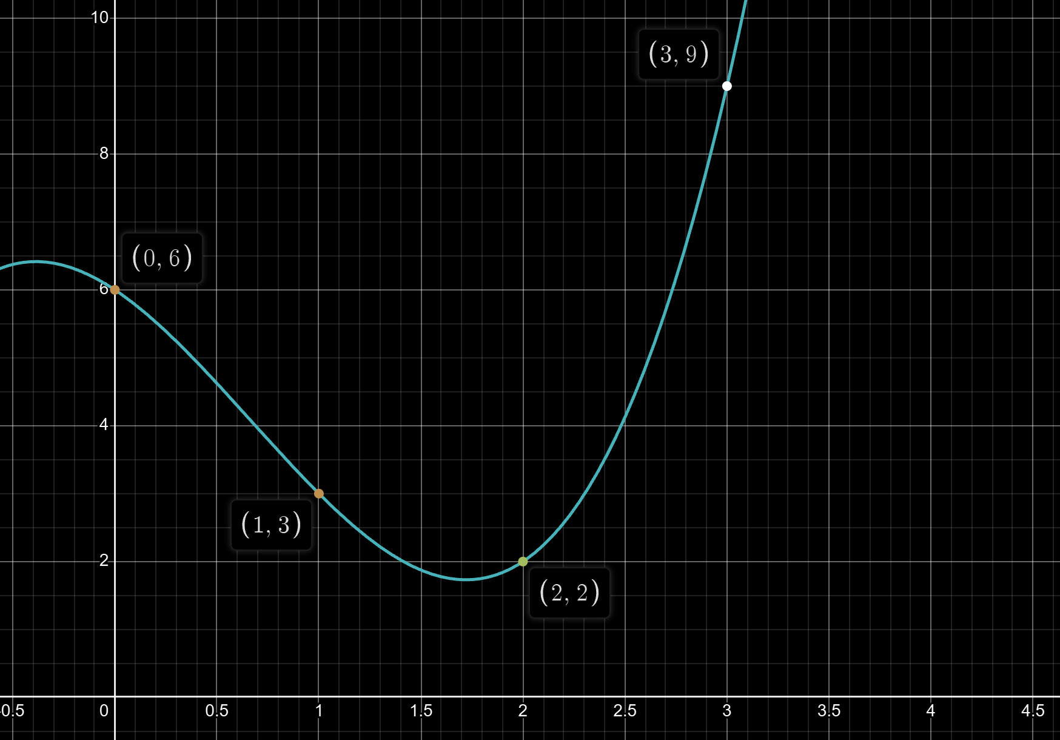
$$f\left(x\right)=m_{0}+m_{1}x+m_{2}x^{2}+m_{3}x^{3}$$

Slide 6

$$GF(8)$$

Slide 7


$$GF(8)$$
A field with elements $\{0, 1, 2, 3, 4, 5, 6, 7\}$ and operations $+$ and $⋅$ similar to polynomials of degree $≤$ 2 with coefficients mod 2.

Slide 8




$$GF(8)$$
A field with elements $\{0, 1, 2, 3, 4, 5, 6, 7\}$ and operations $+$ and $⋅$ similar to polynomials of degree $≤$ 2 with coefficients mod 2.
$$5=101$$
$$1x^{2}+0x+1$$

Slide 9
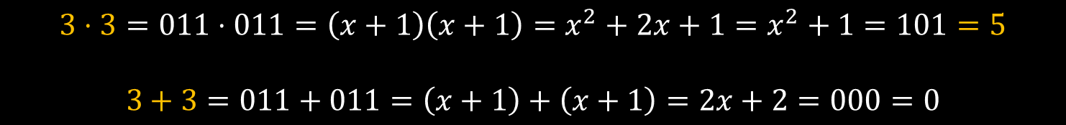
$$GF(8)$$
A field with elements $\{0, 1, 2, 3, 4, 5, 6, 7\}$ and operations $+$ and $⋅$ similar to polynomials of degree $≤$ 2 with coefficients mod 2.
Ex.
$$3⋅3=011⋅011=\left(x+1\right)\left(x+1\right)=x^{2}+2x+1=x^{2}+1=101=5$$
$$3+3=011+011=\left(x+1\right)+\left(x+1\right)=2x+2=000=0$$

Slide 10
$$GF(8)$$
Primitive element: a magic number which, when self-multiplied, generates every non-zero element in the field.
$$1→2→4→3→6→7→5→2$$

Slide 11
$$f\left(x\right)=m_{0}x^{0}+m_{1}x+m_{2}x^{2}+m_{3}x^{3}$$
$$[1 2 4 3 6 7 5]$$

Slide 12
$$f\left(x\right)=m_{0}x^{0}+m_{1}x+m_{2}x^{2}+m_{3}x^{3}$$
$$[1 2 4 3 6 7 5]$$

Slide 13
$$f\left(x\right)=m_{0}x^{0}+m_{1}x+m_{2}x^{2}+m_{3}x^{3}$$
$$1 1 1 1 1 1 1$$
$$1 2 4 3 6 7 5$$
$$1 4 6 5 2 3 7$$
$$1 3 5 4 7 2 6$$

Slide 14





$$f\left(x\right)=m_{0}x^{0}+m_{1}x+m_{2}x^{2}+m_{3}x^{3}$$
$$G_{sym}=\left(\begin{matrix}x^{0} \\ \begin{matrix}x^{1} \\ \begin{matrix}x^{2} \\ x^{3}\end{matrix}\end{matrix}\end{matrix}\right)=$$
$$1 1 1 1 1 1 1$$
$$1 2 4 3 6 7 5$$
$$1 4 6 5 2 3 7$$
$$1 3 5 4 7 2 6$$

Slide 15


$G_{sym}$ encodes a 4-digit message $m$ into a 7-digit code $c.$
$$m⋅G=\left(m_{0} m_{1} m_{2} m_{3}\right)⋅\left(\begin{matrix}x^{0} \\ \begin{matrix}x^{1} \\ \begin{matrix}x^{2} \\ x^{3}\end{matrix}\end{matrix}\end{matrix}\right)=f\left(x\right)=c$$

Slide 16

Quantum Reed–Solomon Error Correction
$$\left[[21,12,4]\right]$$
$$[[21,9,6]]$$

Slide 17
Goal: Implement $G_{sym}$ in quantum circuit.

Slide 18





Goal: Implement $G_{sym}$ in quantum circuit.
c
$$4×7$$
c
$$12×21$$
$$G_{sym}$$
c
$$G_{bin}$$
RREF
$$G_{s}=[I|P]$$
Every entry in $G_{sym}$ is transformed into a $3×3$ matrix.

Slide 19






Goal: Implement $G_{sym}$ in quantum circuit.
c
$$4×7$$
c
$$12×21$$
$$G_{sym}$$
c
$$G_{bin}$$
RREF
$$G_{s}=[I|P]$$
Parity Matrix
If $P[i, j]=1$, $CX($i-th data, j-th parity)

Slide 20


Goal: Implement $G_{sym}$ in quantum circuit.
c
$$4×7$$
c
$$12×21$$
$$G_{sym}$$
c
$$G_{bin}$$
RREF
$$G_{s}=[I|P]$$
Parity Matrix
If $P[i, j]=1$, $CX($i-th data, j-th parity)

Slide 21






Goal: Implement $G_{sym}$ in quantum circuit.
$$12×12$$
$$12×9$$
$$12×21$$
$$G_{s}=[I|P]$$
$$G_{bin}$$
$$H=[P^{T}|I]$$

Slide 22


Goal: Implement $G_{sym}$ in quantum circuit.
Encoder
$$G_{s}=[I|P]$$
Quantum
Circuit
Decoder
$$H=[P^{T}|I]$$

Slide 23
Goal: Implement $G_{sym}$ in quantum circuit.
Encoder
$$G_{s}=[I|P]$$
Decoder
$$H=[P^{T}|I]$$
Syndrome

Slide 24
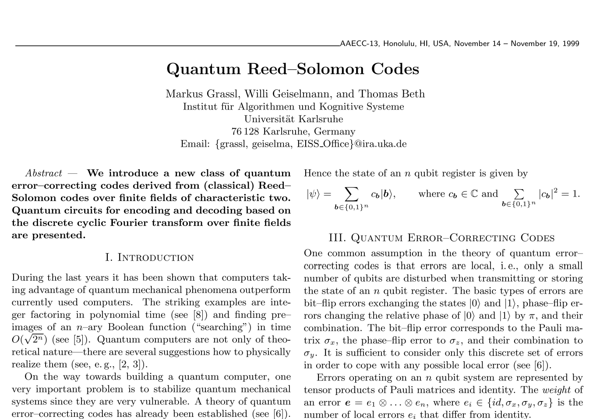
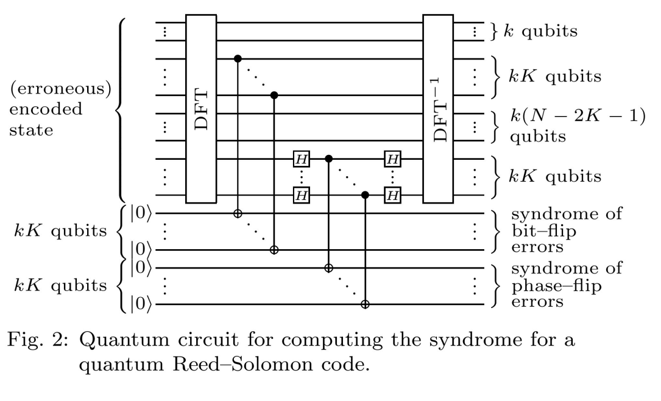
Existing Quantum RS Implementations
For cat qubits, unnecessarily corrects phase flip errors
DFT requires non-Cliffords and is not implementable with Stim

Slide 25
Repetition vs. Reed-Solomon
Pros: Repetition
Pros: Reed-Solomon
Simple, easy to implement and decode, robust against errors
High code rate, robust against bursts and erasures, optimal code distance
Cons: Repetition
Cons: Reed-Solomon
Poor code rate, bad at handling bursts of errors
Computationally intensive, harder to implement and decode

Slide 26
Tornados: Best of Both Worlds
Complexity separation allows both codes to contribute
Repetition (or other LDPC codes) deal with sparse error cases
R-S code receives dramatically reduced workload
Result is much faster than R-S and much more reliable than repetition
Raw message is encoded using repetition (fast)
Repeated message is encoded using Reed Solomon (reliable)
Decryption occurs in the opposite direction

Slide 27
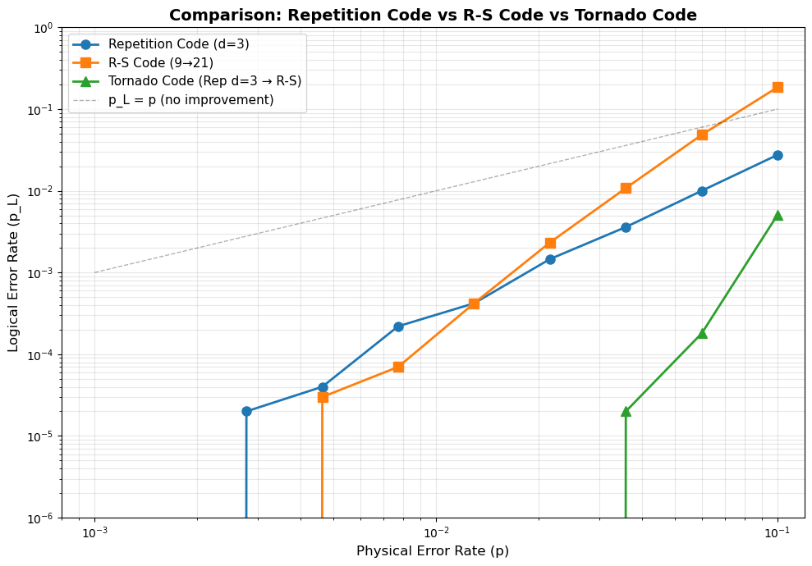
Quantum Tornado
To the best of our knowledge, we introduce the first instance of a tornado code for quantum error correction
Layers a repetition code and a quantum Reed-Solomon code
Shows significant advantage over either algorithm
  Over 10^5 tests at each error probability, tornado suppresses 100% of physical error for p<0.03
  Up to p=0.1, tornado is far better than each individual algorithm
10^6 tests simulated in 8.5 seconds with Stim

Slide 28
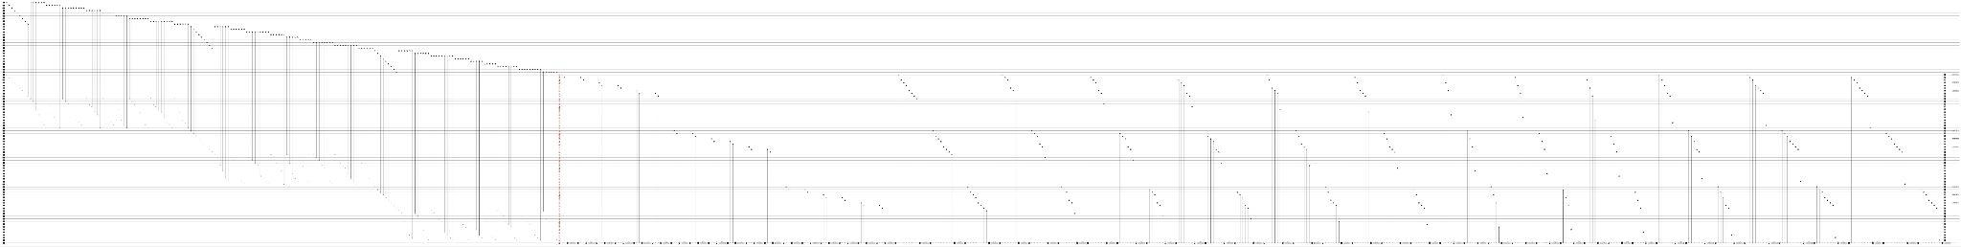
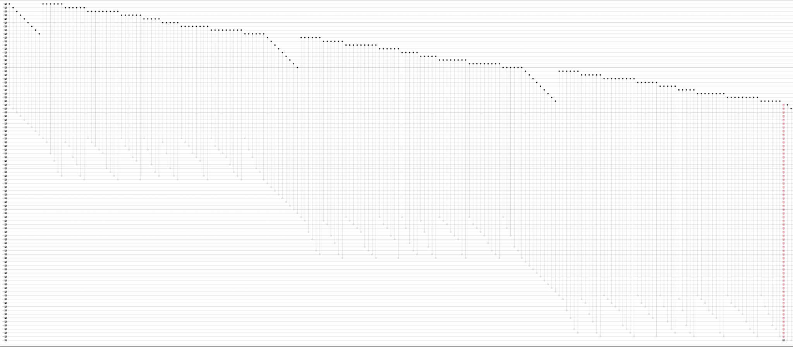
9 logical qubits
27 intermediate qubits
63 final message qubits
Can be changed for any repetition count and R-S code
Repetition module

Slide 29
Key Metrics
Connectivity
Code Rate
Code Distance
Company Name
Month Year

Slide 30
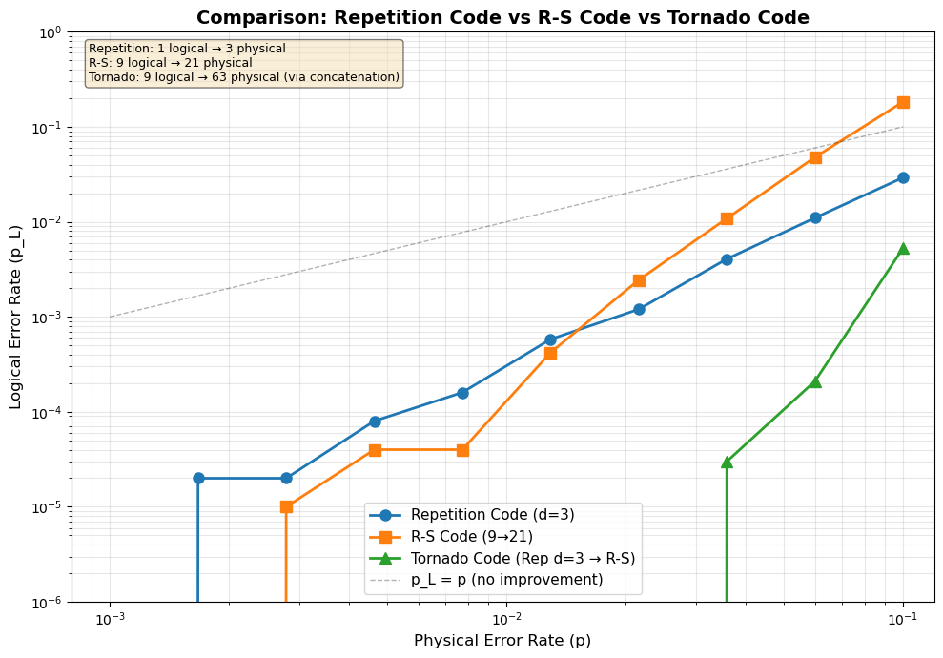
Results
Company Name
Month Year

